Slide 1
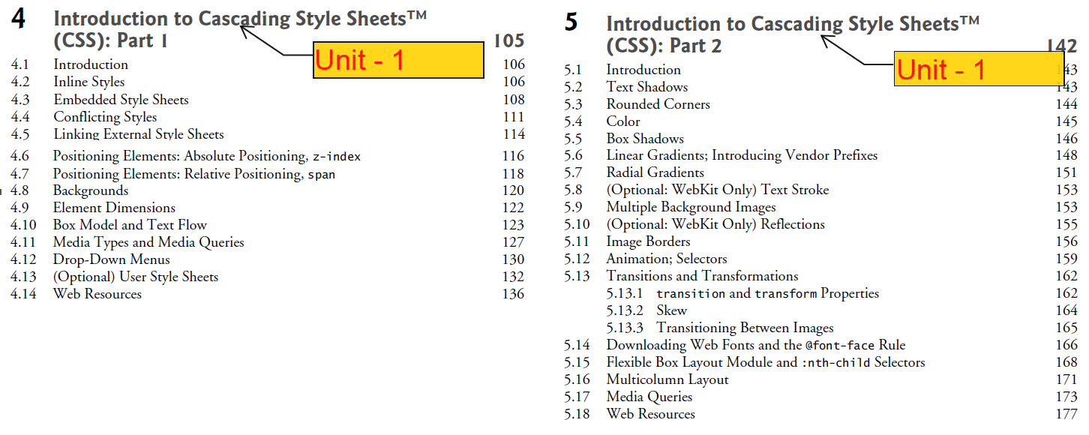
CSS

Slide 2
CSS
Cascading Style Sheets (CSS) is used to format the layout of a webpage.
With CSS, you can control the color, font, the size of text, the spacing between elements, how elements are positioned and laid out, what background images or background colors to be used, different displays for different devices and screen sizes, and much more!
CSS can be added to HTML documents in 3 ways:
Inline - by using the style attribute inside HTML elements
Internal (Embedded)- by using a <style> element in the <head> section
External - by using a <link> element to link to an external CSS file

Slide 3
Style Sheet Attributes
Background-Color
Color
Border Color
Text-align
Font-family
font-size
font-weight
font-style
Margins
Padding
text-decoration
letter-spacing
line-height
text-shadow

Slide 4
Style Sheet Attributes
Backgrounds
Background-Color:blue
background-image:dog.jpg
background-repeat: repeat-y;
repeat-x, no-repeat
background-position:right bottom
background-attachment: fixed
Backgrounds
border-style: solid;
border-width:5pt 10cm 15px 20em;
border-color:red green yellow blue
Positioning Elements:
Absolute Positioning, z-index
Relative positioning

Slide 5
Style Sheet -Example
<p style="background-color:red;
color:Yellow;
text-align:center;
font-family:verdana;
font-size:300%;
font-weight: bold;
font-style: Italic;
margin:75px;
text-decoration:underline;
letter-spacing:-3px;
line-height: 100px;
text-shadow: 3px 2px green; ">
Welcome to RVR </p>
<table border=3 style="
border-color:green;
border-left-color:red;
padding: 25px 50px 75px 100px;
text-decoration:underline;
font-weight: bold;">
<tr align=center >
<th >Roll NO </th>
<th >NAME </th>
</tr>
<tr align=center>
<td>101</td>
<d> abc </td>
<tr>
</table>

Slide 6
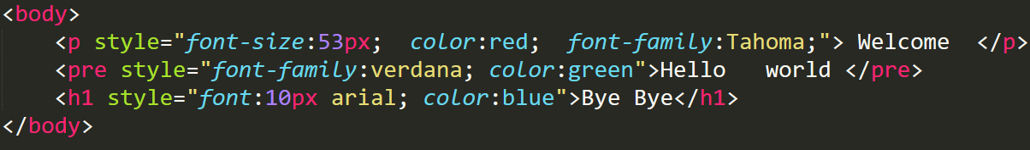
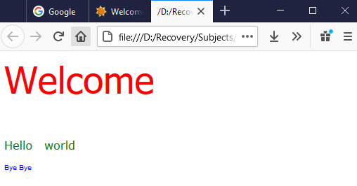
1) Inline Style Sheet
by using the style attribute inside HTML elements
Ex:-

Slide 7
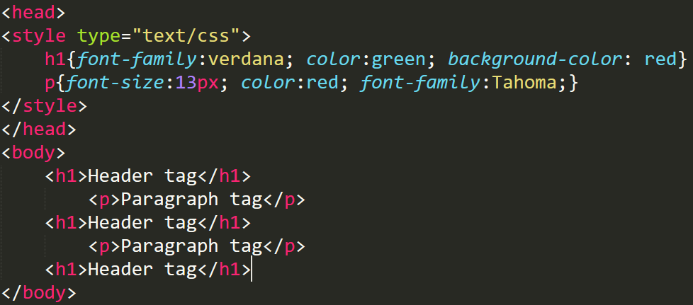
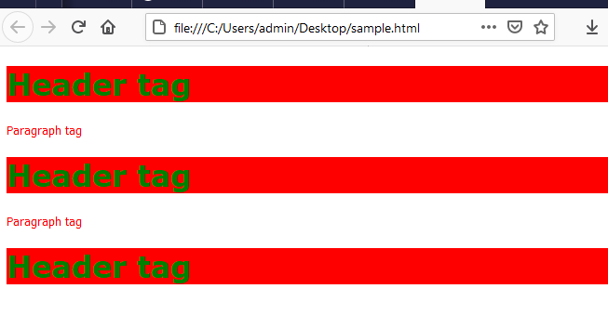
2) Internal Style Sheet (Embedded)
by using a <style> element in the <head> section
Ex:-

Slide 8
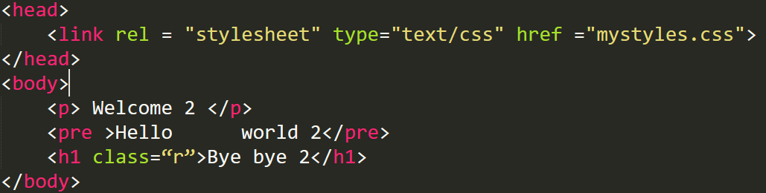
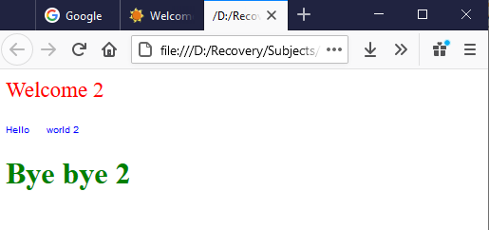
3) External Style Sheet
mystyles.css
h1{color:green;}
p{font-size:23px; color:red;}
.r{color : red;}
by using a <link> element to link to an external CSS file
Ex:-

Slide 9
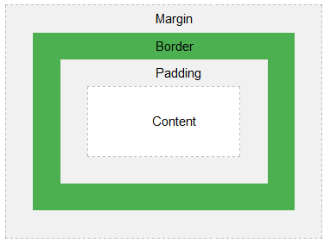
Box Model
All HTML elements can be considered as boxes. In CSS, the term "box model" is used when talking about design and layout.
The CSS box model is essentially a box that wraps around every HTML element. It consists of:
Margins - Clears an area outside the border. The margin is transparens
Borders - A border that goes around the padding and content
padding - Clears an area around the content.
The padding is transparent
Content - The content of the box, where text
and images appear

Slide 10
Box Model Example
<head>
<style type="text/css">
p{
border: 15px solid green;
padding: 50px;
margin: 20px;
}
</style>
</head>
<body>
<p>Welcome to RVR</p>
</body>

Slide 11
Floating and Clear Property
Floating allows you to move an element to one side of the screen; other content in the document then flows around the floated element.
Clear Property specifies on which sides of an element floating elements are not allowed to float.
Ex:-
style="float:left;
style="clear:both“

Slide 12
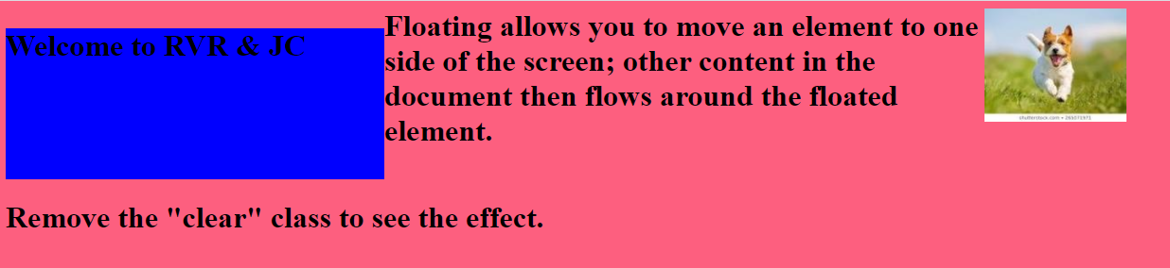
<img src="download.jpg" style="float:right;>
<h1 style="float:left;>Welcome to RVR & JC</h1>
<h1> Floating allows……..</h1>
<h1 style="clear:both">Remove…… </h1>

Slide 13
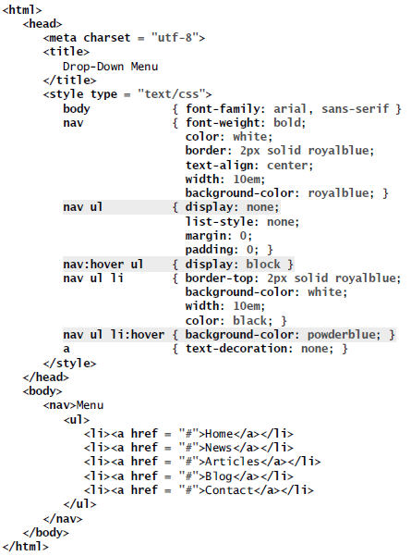
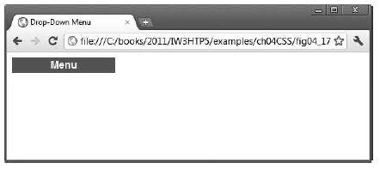
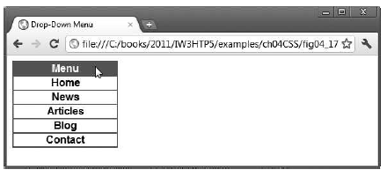
Drop-Down Menus
Drop-down menus are a good way to provide navigation links without using a lot of screen space

Slide 14
CSS – Part 2
Text Shadows | text-shadow: -4px 4px 6px dimgrey;
Rounded Corners | border-radius: 50px;
Color: RGBA ((Red, Green, Blue, Alpha) | background: rgba(255, 0, 0, 0.5);
Box Shadows | box-shadow: 25px 25px 50px dimgrey; box-shadow: -25px -25px 50px dimgrey;
Linear Gradients | background: -webkit-gradient( linear, center top, center bottom, color-stop(15%, white), color-stop(50%, lightsteelblue), color-stop(75%, navy) ); background: -moz-linear-gradient( top center, white 15%, lightsteelblue 50%, navy 75% ); background: linear-gradient( to bottom, white 15%, lightsteelblue 50%, navy 75% );
Radial Gradients | background: -webkit-radial-gradient(center, yellow, red); background: -moz-radial-gradient(center, yellow, red); background: radial-gradient(center, yellow, red);
Text Stroke | -webkit-text-stroke: 2px black;
Programs:- Please refer to the Textbook

